Slide 1
Outline
Introduction
Related work
Methodology
Experiments

Slide 2
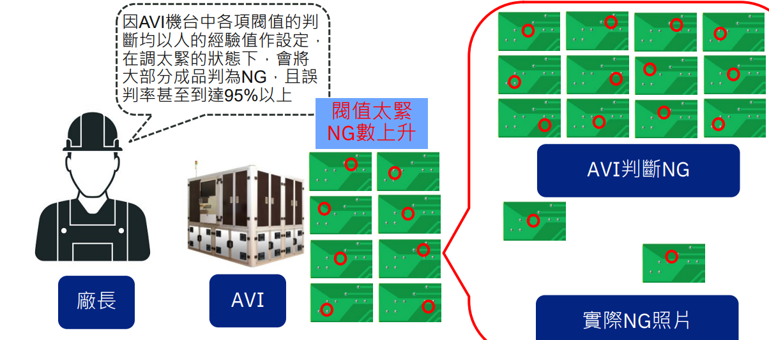
Introduction
Traditional AOI machine high overkill

Slide 3
Introduction
Defect image is rare
🞑 2023 Week 45 data type distribution

Slide 4
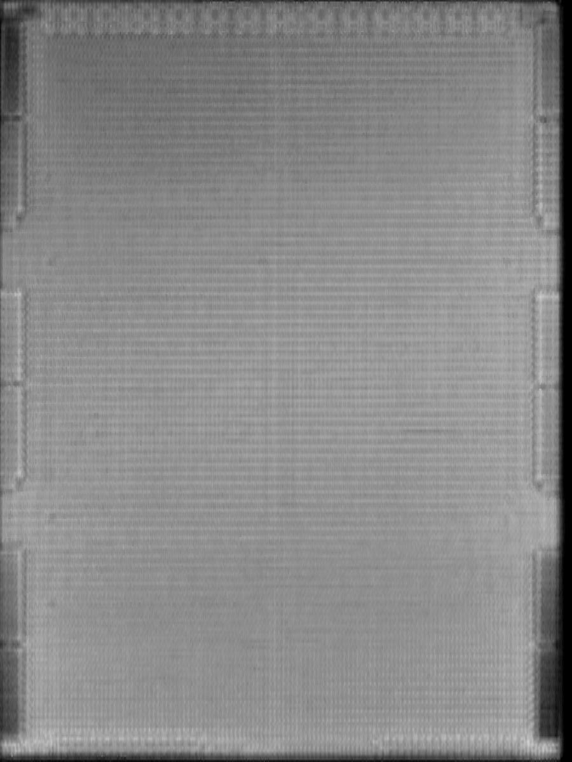
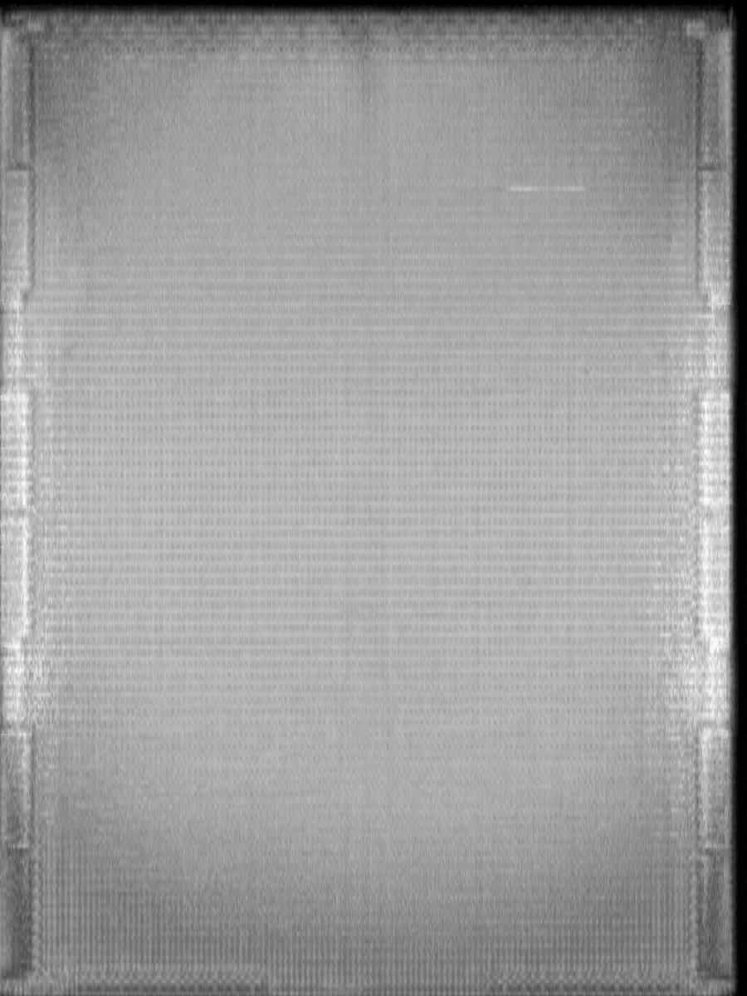
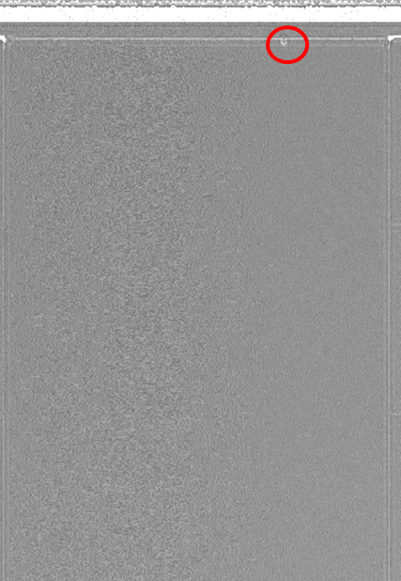
Introduction
SAT(AOI machine) image
Pass image Defect type A image Defect type B image

Slide 5
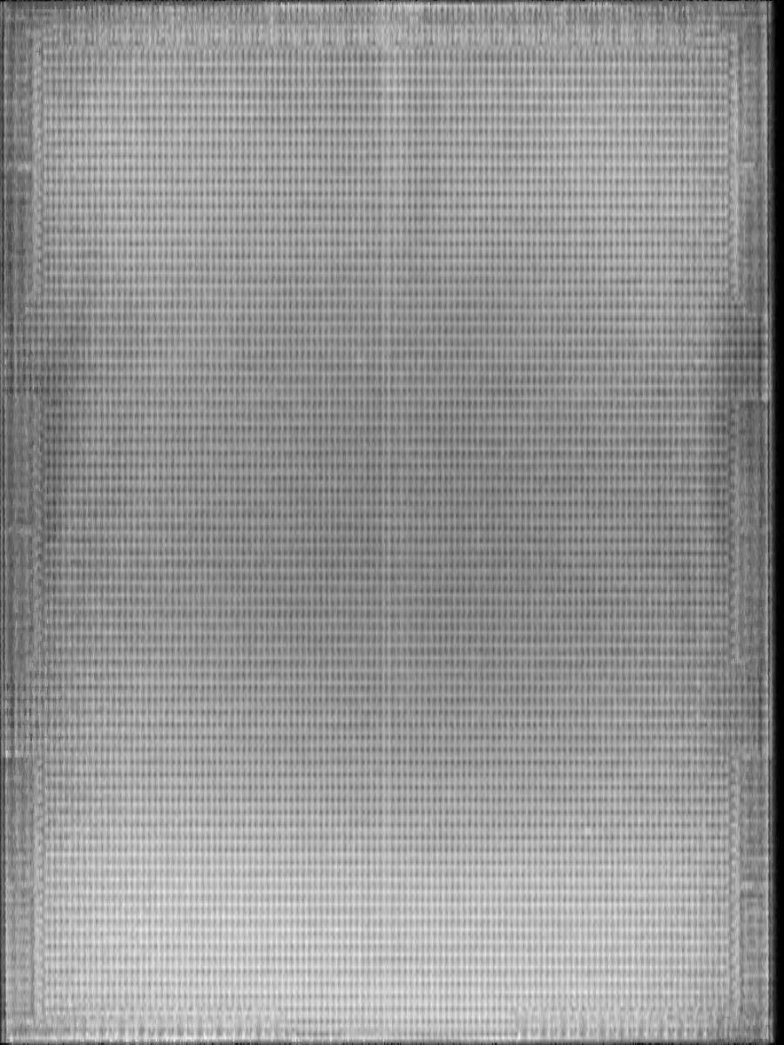
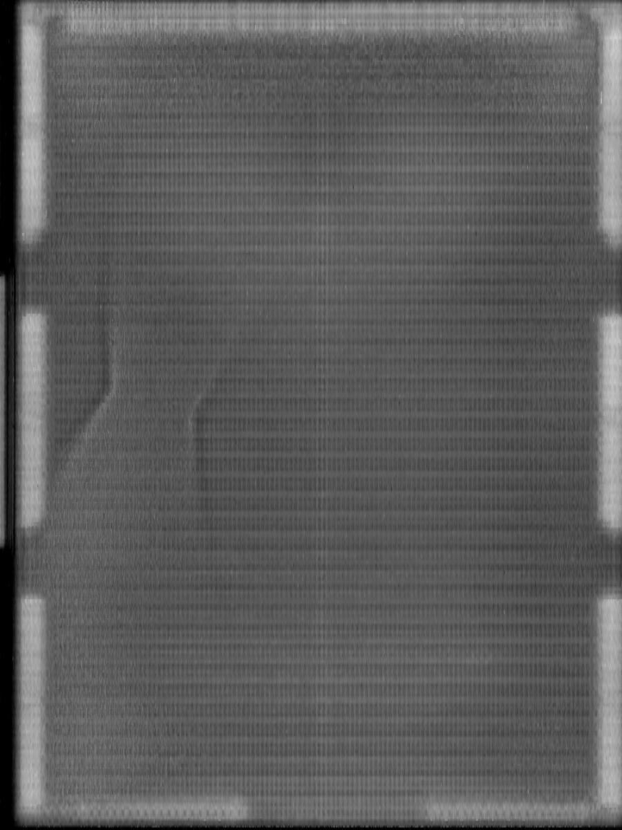
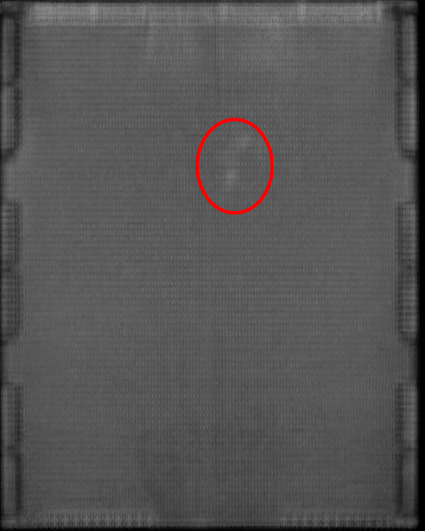
Introduction
SAT(AOI machine) image
Defect type C image Defect type D image Defect type E image

Slide 6
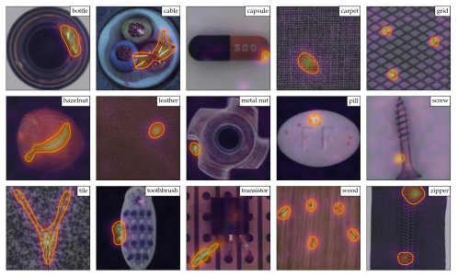
Related work
A Towards Total Recall in Industrial Anomaly Detection
Karsten Roth , Latha Pemula , Joaquin Zepeda , Bernhard Scholkopf , Thomas Brox
University of Tubingen , Amazon AWS arXiv:2106.08265
🞑 In this work ,It arises in many industrial scenarios where it is easy to acquire
imagery of normal examples but costly and complicated to specify the expected
defect variations in full
Patchcore in MVTec dataset segmentation result

Slide 7
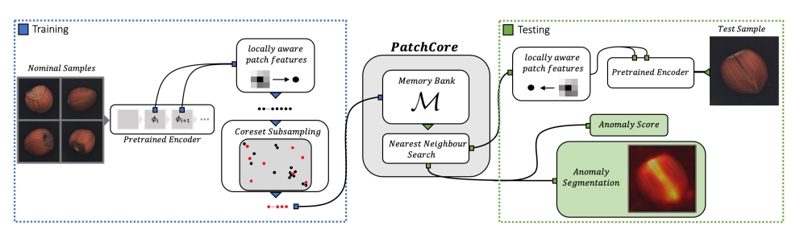
Related work (method)
A Towards Total Recall in Industrial Anomaly Detection
🞑 The PatchCore method consists of several parts that we will describe in sequence
local patch features aggregated into a memory bank a coreset-reduction method
to increase efficiency and finally the full algorithm that arrives at detection and
localization decisions.

Slide 8
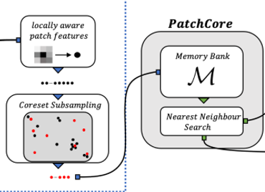
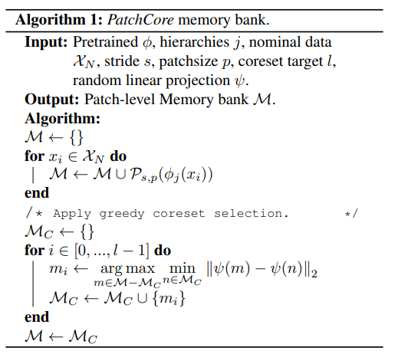
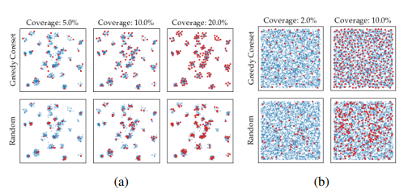
Related work (method)
Greedy coreset selection algorithm

Slide 9
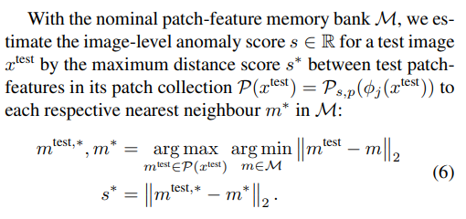
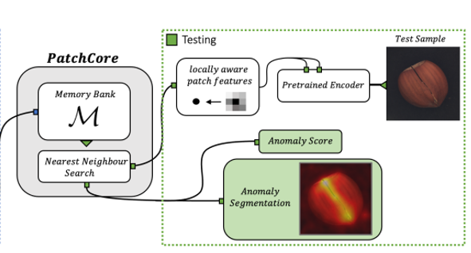
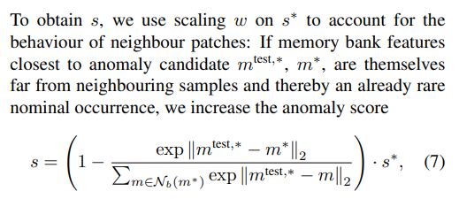
Related work (method)
Inference stage anomaly detection

Slide 10
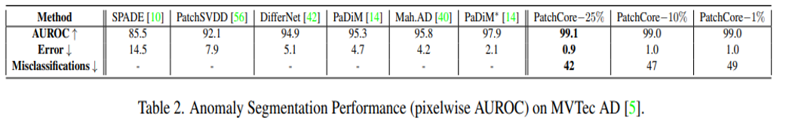
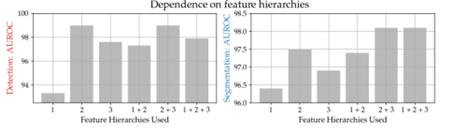
Related work (method)
Experiments

Slide 11
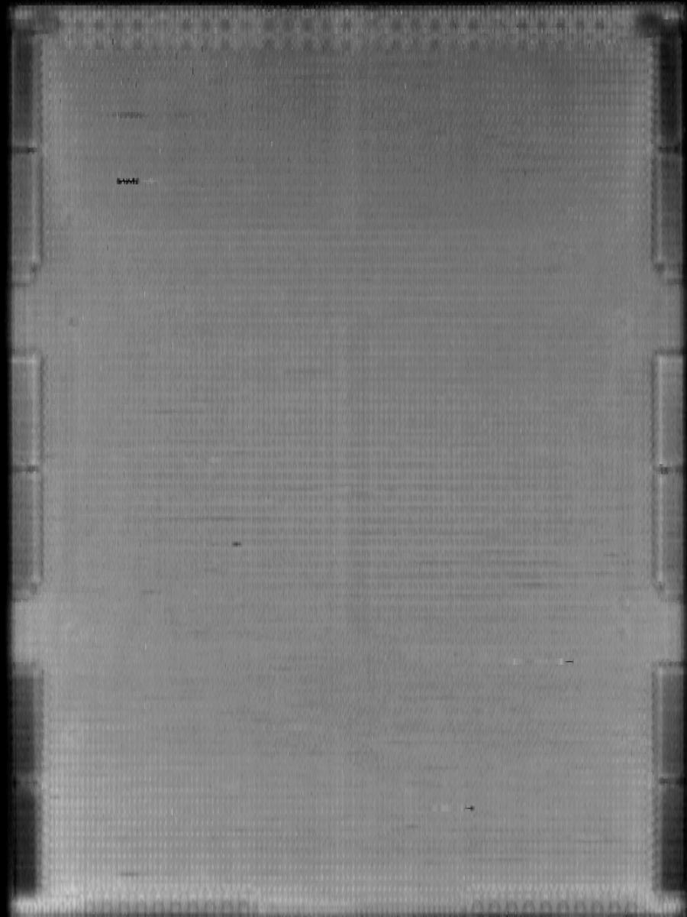
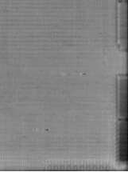
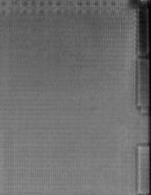
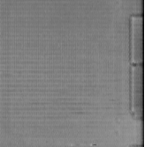
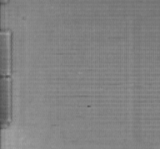
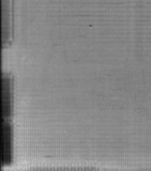
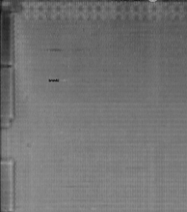
Related work (method)
Image Preprocess
Image size = 900x1200
Image size = 224x224
1
2
Divide to 6 patch(600x600)
And Resize to (224x224)
3
4
5
6

Slide 12
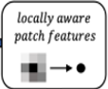
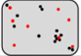
Related work (method)
Training stage
Image size = 224x224
Subsampling
Pretrain encoder
(28x28x512)
Adaptive pooling
(7x7x512)
Extract 10% feature
Patchcore
Pretrain model structure : res2net+transformer
Pretrain method : BYOL (self-supervise) Bootstrap your own latent
Pretrain dataset : Our product data (30M)
Parameter num : 12M
Memory
bank

Slide 13
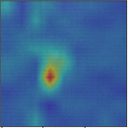
Related work (method)
Testing stage
Image size = 224x224
Patchcore
Memory
bank
Pretrain encoder
(28x28x512)
Adaptive pooling
(7x7x512)
Nearest neighbor
Search
Anomaly score
Pretrain model structure : res2net+transformer
Pretrain method : BYOL (self-supervise) Bootstrap your own latent
Pretrain dataset : Our product data (30M)
Parameter num : 12M
Anomaly
segmentation

Slide 14
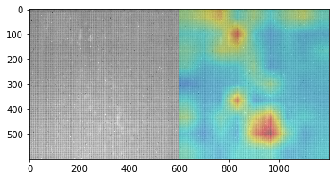
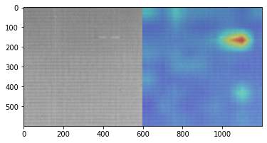
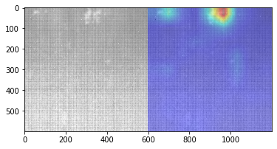
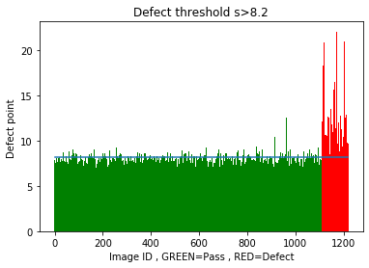
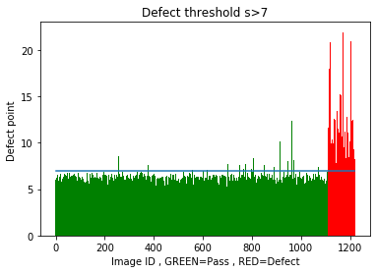
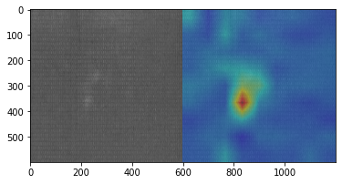
EXPERIMENTS
Patchcore 1%
Patchcore 25%

Slide 15
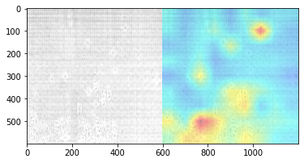
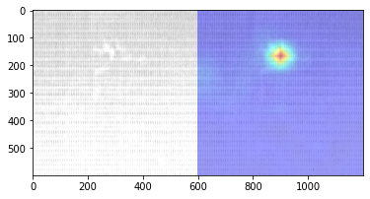
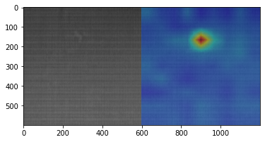
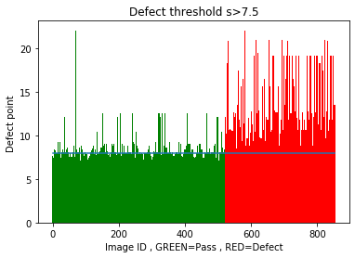
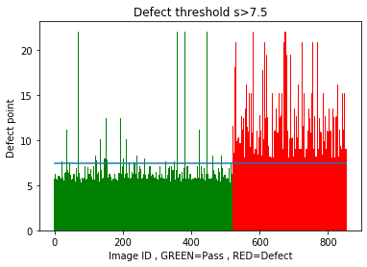
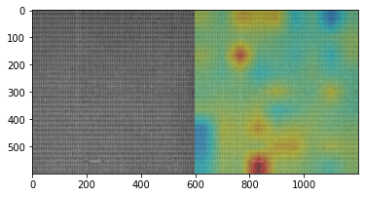
EXPERIMENTS
Patchcore 1%
Patchcore 25%

